Slide 1
Full Guide Web Development in 2024
Created by : Abdul Rehman

Slide 2
How many types developer
Web App Developer
Android & IOS App Developer
Desktop App Developer
Created By: Abdul Rehman

Slide 3
What Does a Web Developer Do ?
[Roles, Responsibilities and Salary]
Created by : Abdul Rehman

Slide 4

Web developers create websites and web apps like Disney, Twitter, and Amazon that you see on the internet. They code the logic behind each feature of the website, create web pages using the designs given by web designers, and take care of all the data the websites collect from the users.
To be a successful web developer you have to understand the client’s problems and requirements and devise a feasible solution. Then you get to use your actual programming skills to convert the solution into a website.

Slide 5
What are the Responsibilities of Web Developers?
Of course, the main responsibility of a developer is coding the web application. A web developer must have extensive knowledge of programming languages and logical thinking abilities to provide the best web-based solutions for clients.
But apart from coding, there are many tasks that come under the profile of a website developer.

Slide 6
Whether you are working as a freelancer or in a multi-national company there are some additional jobs that you will be responsible for as a developer.
Collaborate with client/team (to decide specifications and understand the features required)
Convert wireframes and designs into a working user interface (making the actual website/web app)
Code application logic (writing a step-by-step instruction manual for the computer or browser)
Create cross-platform web apps (sites that work great on a mobile, tablet, desktop and sometimes even Smart TVs)
Test codes and remove errors (review your own or other developer’s programs)
Update existing websites

Slide 7
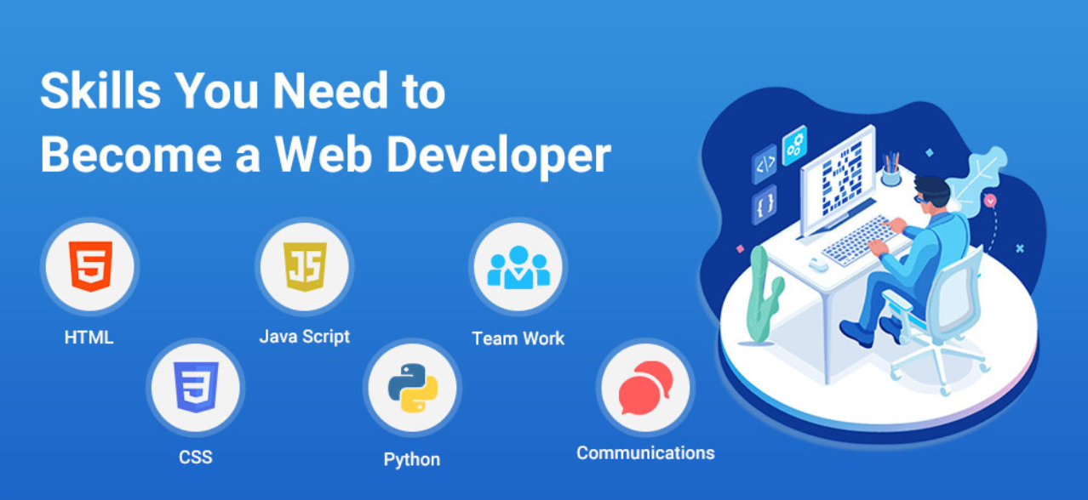
Today, just being a good programmer is not enough to get a web developer’s job. Along with in-depth knowledge about web development languages and frameworks, successful developers also need to have communication and interpersonal skills.

Slide 8
Here is a list of the basic skills you require to become a skilled web developer.
HTML5
CSS
JavaScript
Data structures and algorithms
Web programming languages
Version control systems
Testing and debugging
Web performance principles
Responsive design
Server hosting

Slide 9
Along with technical proficiency, aspiring web developers also need to have strong interpersonal skills to work in the tech industry. Some soft (personal) skills you will require-
Strong problem-solving abilities
Analytical thinking
Creativity
Strong communication
Collaboration and teamwork

Slide 10
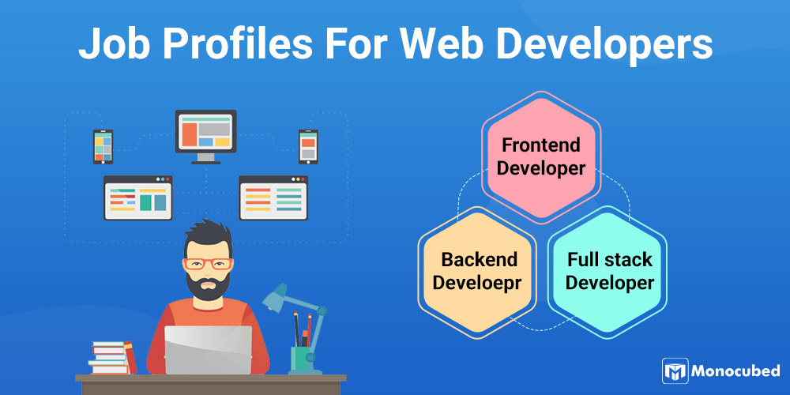
The roles and responsibilities of a developer changes with the kind of job profile and company they work in. Freelance web developers or startup tech teams require knowledge of both back-end and front-end development. But enterprise-level companies have dedicated jobs for developers that require specialization in a programming language or technology. They may use Best AI for job seekers or specialized recruitment tools to find developers with the exact skills they need.

Slide 11
There are mainly three types of profiles for web developers available today-
Front-end web developer
Back-end web developer
Full-stack web developer
Front end Developers
Let’s take the example of Netflix.com to understand the main role of front-end web developers. A trailer of some new releases will be playing as soon as the page loads. You can swipe to see the previews of 5 or 7 popular movies and series. If you scroll, you will see a grid of movies and tv shows for viewing. Hovering over any movie will start a preview.

Slide 12
Wondering what skills you will need as a frontend developer?
If you are aspiring a career in front-end development, here is a list of skills you need to develop to have a successful career.
HTML and CSS – for building the layout of the website
JavaScript – for adding dynamic content like images, scrolling, animation
CSS frameworks like BootStrap, Foundation or Bulma and CSS preprocessors like SASS or LESS offer templates and pre-written code snippets for efficient coding.
JavaScript frameworks and libraries such as jQuery, EmberJS, React or VueJS for simplifying and speeding up the entire development process.

Slide 13
Responsive design for cross-platform compatibility, that is the website looks good on any device be it a smartphone, tablet or desktop.
Version control for managing different updates and keep a track of changes in code
Testing and debugging process for an error-free code
Building and automation tools and web performance optimization (WPO) techniques for enhancing the performance and speed of websites.
Optional – Google Developer Tools and Browser tools to optimize website for different web browsers
Optional – Search Engine Optimization (SEO)

Slide 14
Back-end Developers
Back-end web developers code the logic behind the website. They instruct the servers, database, and browsers to interact with each other and display the right content on the web page when a user requests something.
Continuing our example of Netflix, let’s understand what the role of a backend web developer is. Each user will get different recommendations on their Netflix page based on their watch history. This is because of the database that backend developers handle, which collects user data, analyses and runs an algorithm to recommend similar content. Apart from data management, as a backend web developer, you are also responsible for writing the codes for user login, and monthly/yearly payment management profiles.

Slide 15
Wondering what skills you will need as a backend developer?
For a prosperous career in back-end web development, here are some of the technologies you will require –
A strong grasp of one or more backend coding languages- PHP, Java, Ruby, JavaScript, C#, or Python
Backend web frameworks such as Django, Laravel, .NET, Ruby on Rails, Node.js, or Spring will provide libraries and templates so that you can work faster with the programming language.
Data structures and Algorithms – Data structures let you know how to store and manage data. Learning common searching/sorting algorithms is essential for performative, efficient code and building your problem-solving skills.
Database languages – SQL and NoSQL are languages that actually tell the device to store information in memory using data structures like tables or arrays.

Slide 16
Database management systems such as MongoDB, PostgreSQL, or MySQL use SQL or NoSQL to create relationships between the stored data and perform operations on it like adding, modifying, searching or making queries.
Networks and servers to understand how the World Wide Web(www) works and how you can host the website on the internet.
Knowledge of APIs- They control the transfer of data between database and web servers.
Version control with Git to help you track changes in your code.
Optional – Server hosting environments like Apache, Nginx, IIS servers, or Microsoft IIS
Optional – Cloud hosting platforms such as AWS, Heroku, Google Cloud Platform

Slide 17
Full-stack Developers
Full-stack development entails working on the whole tech stack of a web project. This means working with a frontend framework, database technology, backend language, server, operating system, and testing tools.
Full-stack web developers are involved throughout the web development process. Since they have both frontend and backend skills along with in-depth knowledge of databases, they can successfully build websites and web applications single-handedly.
A wider knowledge base and multitasking are key requirements for a career in full-stack development. Apart from the front-end and back-end development skills, full-stack developers should also be proficient in-
HTTP and REST – the connecting link between frontend and backend codes
Web architecture
Basic design capabilities
Internet security

Slide 18
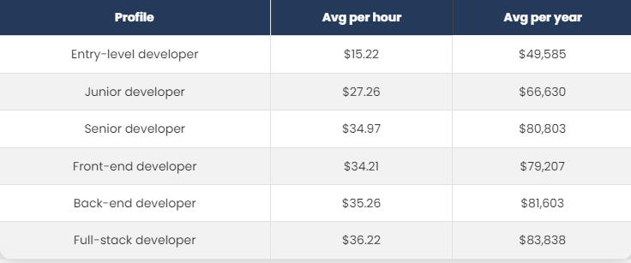
What is the Average Salary for Web Developers?
In a world that is going online, web developers are, without a doubt, one of the highest-paid software developers. The range of salaries for web developers in Canada is $49,585 to $83,838 annually depending on the job profile you use. We have created a list of average salaries for different job profiles of web developers in Canada.

Slide 19
You are learning languages in this YouTube channel
HTML 5
CSS
JavaScript
Bootstrap
Typescript
Tailwind CSS
React JS
React redux
Firebase
Next JS
Material UI
ShadeCN
Node JS
Express JS
Mongo DB
SQL
MY SQL
Postgre SQL
PHP
Laravel
Python
D Django
Data Science
Web SEO
Artificial Intelligence
Other Libraries & Framework’s & Programming Languages
React Native
Electron JS

